Slide 1
Bluestone Hacks Presentation
Misran Dolan

Slide 2

Looking at the Big Picture
My project is creating an app that measures fuel consumption and outputs a price for how much you drove
When carpooling, there is limited knowledge on compensating the driver
This is to benefit the driver and the rider
The driver knows how much to charge
And the rider knows that he won’t be overcharged

Slide 3
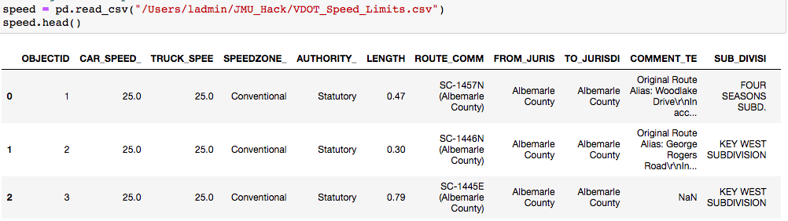
2. Starting with VDOT Data
Downloaded the Speed Limit .csv to determine which roads are in the city or highways based on speed limits

Slide 4
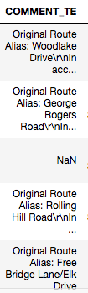
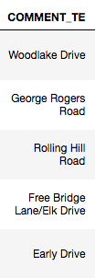
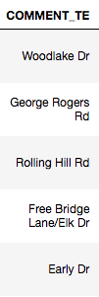
3. Cleaning the data for Google Maps
We plan to cross reference the roads with Google Maps
So we have to make sure it fits the format for their API

Slide 5
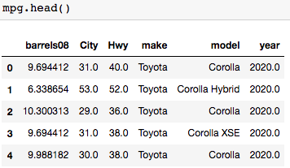
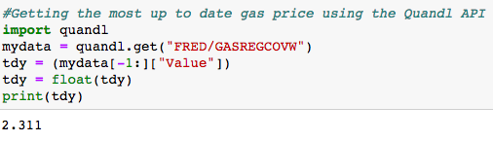
4. Importing Car and Gas Data
Gathering current gas prices and car fuel efficiency data for fuel consumption calculations

Slide 6
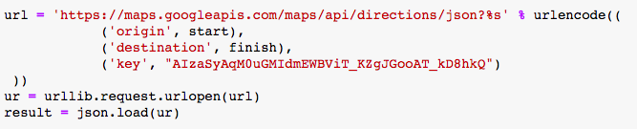
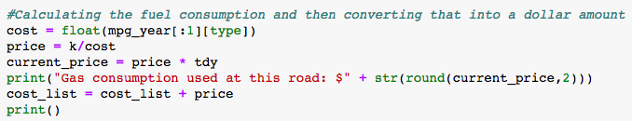
5. Implementing Google Maps API
Retrieve the directions data from the Google Maps API
Check the road abbreviation to determine highway or city mileage
With the inputted car data and abbreviation, filter through the mileage data set to retrieve a value
Divide the distance by the mileage, then multiply by the current gas price to retrieve gas consumption in dollar amount

Slide 7
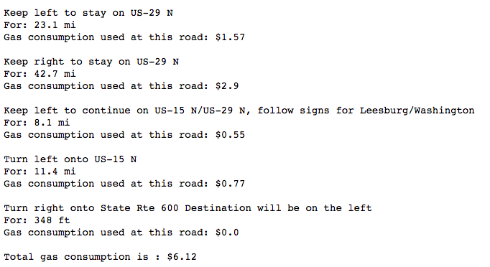
6. Example

Slide 8
7. Problems
Due to time constraints I was not able to:
Implement an interactive dashboard or website for visual appeal
Fully use the Speed Limits .csv
I wanted to cross reference every road into the .csv but due to time and error I was not able to implement it into my code

